Slide 1
Algorithms in Automotive Inverter
Motor Control and Beyond
Motor Control and Beyond
Notes:
Specialist topic

Slide 2
Inverter
What is an Inverter?
P_{out} / P_{loss}
Inverter
=
~
Motor
Battery
~
Power losses
Notes:
e.g.
νψ₁ = 95% → νψ₂ = 97.5%
P_{out2} ≈ 200% ∙ P_{out1}
An inverter is a power electronic device, which supplies the connected devices with suitable voltages and currents. It transforms the direct currents and voltages of the battery in alternating values in order to drive the motor. In the other direction, the inverter charges the battery with direct current generated by the alternating current of the motor.
A major concern is the power losses P_{loss}, generated by the conversion. These losses are the excess heat and have to be conducted to the cooling system in order to limit the temperature. Therefore, the more losses are produced the larger the inverter will get.
In automotive applications the size is limited by the installation space specification of the vehicle.
In order to get more output power P_{out} per power loss P_{loss} the efficiency η of the inverter has to be raised. The relationship between the factor “output per loss” and the efficiency is the following:
$\frac{P_{out}}{P_{loss}}=\frac{η}{1−η}$ (1)
The increase from 99% efficiency to 99,1% corresponds to a possible increase of the output power of about 11% at similar power losses.

Slide 3
System Architecture
How to Control an electric Motor?
+U_{batt} / 2
„out“
Gate Driver
S
N
SW Driver
-U_{batt} / 2
Notes:
In order to control the motor one has to understand the steps between the controller in the software down to the rotating axis of the motor.
The motor consists of rotor and stator. In the following a permanent magnetic synchronous motor with 3 phases is explained and controlled. There, the 3 coils on the stator generate a rotating magnetic field in order to create a force on the permanent magnet of the rotor. The cause of the rotating magnetic field is the current flowing through the coils.
This current is driven by applied voltages. The alternating voltages are given by half bridges and are applied on motor phase input. Each half bridge has to sample a sinusoidal curve by modulation, e.g. pulse width modulation. In order to do so, the transistors have to be switched correctly timed.
The impulse for the switches is supplied by the gate driver. Its task is to supply enough current at the right time to get the transistors in a conducting state.
The software has to supply the timing. This is achieved in different levels from physical calculation down to software driver sending the timing to the gate driver.

Slide 4
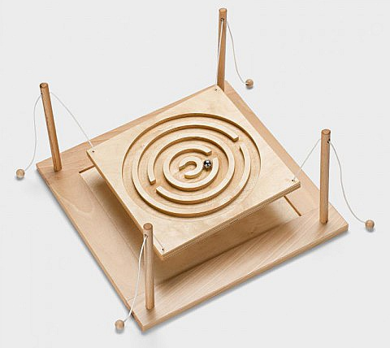

Point of View
How to Control the AC values?
Source: Biber.de
Source: crazynormalvids@youtube.com
Notes:
I would have to explain the DC motor and ist control first, but since we are more interested in Synchronous motors, and especially ist software I‘ll take a shortcut.
The output signals of the inverter are alternating voltages. Controlling three alternating voltages, that are in a distinct way connected together is possible (see U/f control or Direct Torque Control). However, a transformation into direct values would be more advantageous regarding efficiency and use of control theory.
In order to do so the control signals and system output have to be transformed.
In the following explanation different assumptions were made:
Symmetry: the ohmic resistance R and the induction of the coils (without rotor influence) of all phases are similar. Additionally, the supplied voltage is symmetric by a phase shift of 120°.
Pole pairs: the system only has a single pole pair. I.e. every phase supplies only one coil. Therefore, a single dipole field is generated by the stator. The rotor also has a single dipole field.
Magnetic simplification: saturation of the magnetized material is neglected.
Virtual ground: The star point does not experience any net current and has ground potential. This is caused by phase shifts of 120° between two phase inputs, which cancel out the sum of all three inputs at the star point. Consequently, the voltage equations can be separated and the third dimension of the coordinate systems (α,β,0) and (d,q,0) is canceled out.

Slide 5


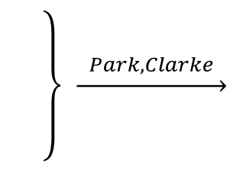




Field oriented Control
… from another angle
Stator
Rotor
a
q
L
b
$$\underset{→}{ Park,Clarke }$$
S
N
d
c
$$u_{a}=R∙i_{a}+\frac{d}{dt}φ_{a}$$
$$\left.\begin{matrix} \\ \begin{matrix} \\ \\ \end{matrix} \\ \end{matrix}\right\} \underset{→}{ Park,Clarke }$$
$$u_{d}=f\left(i_{d}, i_{q}, ω\right)$$
$$u_{b}=⋯$$
$$u_{q}=f\left(i_{d}, i_{q}, ω\right)$$
$$u_{c}=⋯$$
Notes:
The motor inputs are the three voltages given in a coordinate system (a,b,c), that reflects the three phases. The voltages equals the ohmic voltages drop plus the time derivative of the magnetic flux through each coil. The transformation from 3-phase stator coordinates to 2-phase rotor coordinates is divided into two steps:
The Clarke transformation creates a 2-phase system in the frame of reference of the stator. The factor of $\frac{2}{3}$ has to be considered in order to conserve the energy and therefore is multiplied on the voltages.
$\left(\begin{matrix}i_{α} \\ i_{β}\end{matrix}\right)=\left(\begin{matrix}1 & −\frac{1}{2} & −\frac{1}{2} \\ 0 & \frac{1}{2}\sqrt{3} & −\frac{1}{2}\sqrt{3}\end{matrix}\right)∙\left(\begin{matrix}i_{a} \\ i_{b} \\ i_{c}\end{matrix}\right) \left(\begin{matrix}u_{α} \\ u_{β}\end{matrix}\right)=\frac{2}{3}∙\left(\begin{matrix}1 & −\frac{1}{2} & −\frac{1}{2} \\ 0 & \frac{1}{2}\sqrt{3} & −\frac{1}{2}\sqrt{3}\end{matrix}\right)∙\left(\begin{matrix}u_{a} \\ u_{b} \\ u_{c}\end{matrix}\right)$ (2)
The Park transformation generates a rotating 2-phase coordinate system with the d axis aligned to the axis of the magnetic dipole.
$\left(\begin{matrix}{\left[\right]}_{d} \\ {\left[\right]}_{q}\end{matrix}\right)=e^{−jφ}∙\left(\begin{matrix}{\left[\right]}_{α} \\ {\left[\right]}_{β}\end{matrix}\right)$ (3)

Slide 6



Field oriented Control
… from another Angle
Rotor
N
Lorentz
q
S
$${F_{L}\sim i}_{q}∙φ_{PM}$$
S
N
d
Reluctance
$$F_{R}\sim i_{q}∙i_{d}∙\left(L_{d}{−L}_{q}\right)$$
$$u_{d}=f\left(i_{d}, i_{q}, ω\right)$$
Torque
$$u_{q}=f\left(i_{d}, i_{q}, ω\right)$$
$M=f\left(i_{d}, i_{q}\right) \sim$ $F_{L}\left(i_{q}\right)+F_{R}\left(i_{q},i_{d}\right)$
Notes:
Permanent magnets burried in rotor sheets of electrical steel
Shown in picture: electric dipole
There are two main forces, that can be used in order to rotate the rotor.
The Lorentz force on the rotor is the reaction force onto the permanent magnets on the rotor, since the stator is fixed. The magnetic dipole for this force is fixed on the d axis, coining the axis as “direct axis”.
$F_{L}=I∙\left(\vec{l}×\vec{B}\right) \overset{→}{} F_{L}\sim i_{q}∙φ_{PM}$ (4)
The Reluctance force is based on the differences of “conducting” the magnetic flux in q and d axis. The magnetic resistance (also called reluctance) depends on the dimensions and the permeability in the two axis.
The permanent magnets are buried into the rotor sheets of iron, in most of the present motors (termed: hybrid permanent magnetic synchronous motors). The relative permeability of the magnets – i.e. the conductivity of external magnetic flux $φ_{S}$ - is similar to the permeability of air. Therefore, the reluctance is lower on the q axis. Since the force is proportional to a squared current, the axis is called “quadratic axis” ¹⁾.
$F_{R}\sim I^{2} \overset{→}{} F_{R}\sim i^{2}∙\left(1−\cos\left(2∙∠\left(φ_{PM},φ_{S}\right)\right)\right)=i_{d}∙i_{q}$ (5)
The forces applied to the rotor generatesa torque $M$, which is driving the rotor.
The systematic deviation of the relationship between the currents $\left(i_{d}, i_{q}\right)$ and torque $M$ is based on equality between the generated mechanic power and the initial electric power.
___________
¹⁾ In German literature the q axis is often the abbreviation for “quer”, instead of quadratic

Slide 7















Field oriented Control
Field oriented Control (exemplary for q-part)
Differential equation of the system
$$u_{q}=R_{s}∙i_{q}+L_{q}∙\frac{d}{dt}i_{q}+ω∙\left(L_{d}∙i_{d}+φ_{PM}\right)$$
$$ω∙φ_{PM}$$
$$φ$$
Motor
$$u_{\left[a,b,c\right]Des}$$
$$i_{\left[a,b,c\right]Act}$$
M_{Des}
$$u_{dDes}$$
Table
$$i_{qDes}$$
$$u_{qDes}$$
d
a
_
PI
+
q
b
$$\begin{matrix}U_{max} \\ ω\end{matrix}$$
+
c
$$i_{qAct}$$
$$φ$$
P
$${{ωL}_{d}∙i}_{dAct}$$
$$i_{dAct}$$
$$i_{qAct}$$
d
a
q
b
c
$$φ$$
Notes:
In the following step, only the control of the current in q axis is shown. The control in d axis has a similar topology, with different parametrization.
Based on the (d,q) transformation, the relationship between currents $\left(i_{d}, i_{q}\right)$ and torque $M$ was shown one slide before. The motor can be driven by the current $i_{q}$ only, but in order to be efficient the distribution in both direction has to be taken into account. Additionally, the limitation by maximum current and maximum voltage have to be considered. This is done by the control algorithms “maximum torque per ampere” (MTPA) and “maximum torque per voltage” (MTPV). The generated optimized relationship$M\left(i_{d}, i_{q}\right)$ can be inversed in order to get the desired currents $\left(i_{dDes}, i_{qDes}\right)$ for a distinct torque. This is done offline and put into look-up tables with an additional dimension for the relation to the maximum battery voltage and the current motor speed.
The error signal for the control is calculated as the difference between the transformed actual currents $\left(i_{dAct}, { i}_{qAct}\right)$ and the value of the look-up table.
The differential equation describing the motor consists of several parts. The PT1 element $u_{PT1}=k_{1}∙i_{q}+k_{2}∙\frac{d}{dt}i_{q}$can be controlled by PI controller. The transformed actual current $i_{dAct}$ on perpendicular axis is multiplied by a factor and added to the voltage, in order to take care of the cross coupling. The synchronous generated voltage – also called counter EMF – has only to be taken into account for controlling $i_{q}$. It is also added to the output of the PI controller.
The shown method of controlling the motor is called field oriented control. In order to calculate the transformation, the inverter needs to acquire information of the actual rotation position $φ$of the rotor. It can be derived from a sensor or by using test pulses on the voltage and measuring the current reaction.

Slide 8
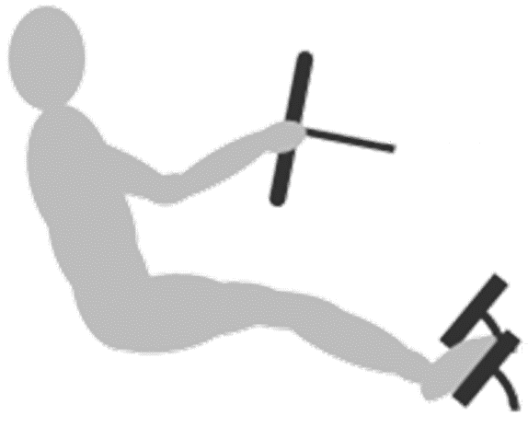
Field oriented Control
Where does the Desired Torque come from?
From driver
Vehicle control managing external boundaries
e.g. from brake system or battery
Internal limitations (e.g., for over-current)
Active damping of drivetrain oscillations
Limiter
Anti
Jerk
Field oriented Control
Motor
Battery
M_{Des}
Modul-
ation
Table
PI
q
a
Electronic
Stability
System
-
d
b
c
Vehicle
Control
Unit
CAN
Inverter
Notes:
The desired torque for the field oriented control has its origin on the position of the acceleration pedal – the driver request – but it is not directly fed into the control.
The position of the pedal is acquired by the vehicle control unit (VCU). It is connected with the other control units via CAN. The VCU limits the driver request depending on the input of the battery management system and the electric stability system. It also divides the torque request onto multiple electric motors and the combustion engine, if available.
The inverter receives the prepared driver request from the VCU. The control also has to respect the internal limitations of the inverter, e.g., over-current or over-temperature. Another implication on the desired torque is given by the anti-jerk function. Its goal is to reduce drivetrain oscillation in order to reduce the stress on the differential gear and the axle.
The presented field oriented control is calculating the desired voltages for the half bridges. The modulation function converts this voltages into timing information for the switches. It has to consider reducing switch losses and avoiding short circuits.

Slide 9


Field oriented Control
What else to do?
Multiple additional tasks
Task management in real time OS
Scheduled periodically
Highest frequency task for modulation (here: 10 kHz)
Limiter
Anti
Jerk
Field oriented Control
Motor
Battery
M_{Des}
Modul-
ation
Table
PI
q
a
Electronic
Stability
System
-
d
b
c
Vehicle
Control
Unit
SW
Sharing
$$ω, U,I$$
Control
Diag-
nostics
State
Machine
State
Detect.
Funct.
Safety
Temp.
Models
PI
M_{Des}
$$φ, ω, M$$
CAN
Inverter
Notes:
Real time OS
There are multiple other functions implemented in the inverter.
The state machine manages the condition of the inverter, like start up, shut down, safe state. Depending on internal values some states are not allowed.
The field oriented control is also nested into other controls. Controlling the DC voltage and current is implemented for tests. The speed control is used for synchronization when the powertrain contains a clutch.
The on-board diagnosis checks all sensors and actuators regularly. It also manages the fault memory.
The control requires a precise value for rotor position, rotor speed and torque given by the state detection. The noise reduction is done by state filters.
A major issue is minimizing the risks and hazards of the inverter. This is covered by the functional safety. One part of functional safety is the software implementation of a redundant and often simplified copy of the control. It also contains an emergency shut-off into a safe state.
Temperature models provide the predicted temperatures of transistor junction, rotor and stator.
Software from external sources have to be implemented, depending on the customer. Software sharing is enabled by provided signal interfaces and hooks.
The software is implemented in a real time operating system, where the tasks are scheduled periodically. The fastest period is used for the modulation of the voltage.

Slide 10
Notes:
Most of the algorithms covered so far were crucial for driving the motor.
It is assumed, that there will be more functionality in the inverter beyond the pure motor control. The reason for this are the differences between electric motors and combustion engine such as their integration into the vehicle. In the following chapter, some of these will be explained shortly.
The hardware dynamics for setting a positive torque in the gasoline engine is given by the time constant of the intake manifold. This constant is in the range of 100..200ms. For electric motors the electric time constant $τ_{e}$ is governing the dynamics. It is given by the inductance and resistance of the motor: $τ_{e}=L/R$ (cp. formula for PT1 at page 7). Often the resistance is virtually increased by inverter in order to increase the dynamics. Common time-constants are in the range of 10..50ms. Furthermore, the electric motor is usually integrated into the vehicle without any gearbox, dual mass flywheel and clutch, and also with shorter axles. This leads to a better prediction of the wheel speed based on the motor speed.
The software dynamics is based on the fastest task period. At the corresponding frequency most of the internal variables, like actual torque or speed, are calculated and provided. For a combustion engine, this is synchronous to the crankshaft (about 1ms at 12’000 rpm for 4 cylinders). The fastest period of the inverter is 100µs independent from the speed of the motor.
The range of negative torque of a combustion engine is limited by the motor drag torque. The electric motor can provide about the same minimum negative and maximum positive torque. The usage of higher negative torque is also beneficial in order to recharge the battery.
Drag Torque
Control

Slide 11
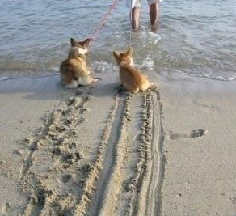

Slip Detection
What is Drag Torque Control?
Source: fotoguzzi@photobucket.com
Source: BoschGlobe125@youtube.com
Notes:
Drag Control = Anti-Lock for motor deceleration
Drag torque control is a functionality of the motor control unit, providing the maximum deceleration force on the vehicle.
The most important figure to monitor is the relative difference between ground speed $v_{ground}$ and the speed $v_{contact}$ contact surface of the vehicle. This value is termed as slip $λ$.
$λ=\frac{v_{contact} − v_{ground}}{v_{ground}}$ (6)
The maximum deceleration force strongly depends on the slip and it drops rapidly when the speed difference increases. Once this loss of traction occur, not only the deceleration force can not be provided, but also the lateral forces for steering the vehicle lose contact.
The anti-lock brake is monitoring the slip in order to avoid this event. When such slipping is detected the deceleration force is reduced to increase the speed of the contact surface again – and therefore decrease the slip.
Another important value for conventional drag control is the friction coefficient. It is a measure for the maximum transmittable force $F_{axle,max}$ relative to the normal force $F_{N}$.
$μ=\frac{F_{axle,max} }{F_{N}}$ (7)
The friction coefficient is strongly related to the friction properties of the surface and the wheels. The maximum force applied for acceleration and deceleration processes is strongly related to the slip. One widely adopted way to simulate the relationship $μ\left(λ\right)$ in the electronic stability system is by means of the so-called Magic Formula.

Slide 12
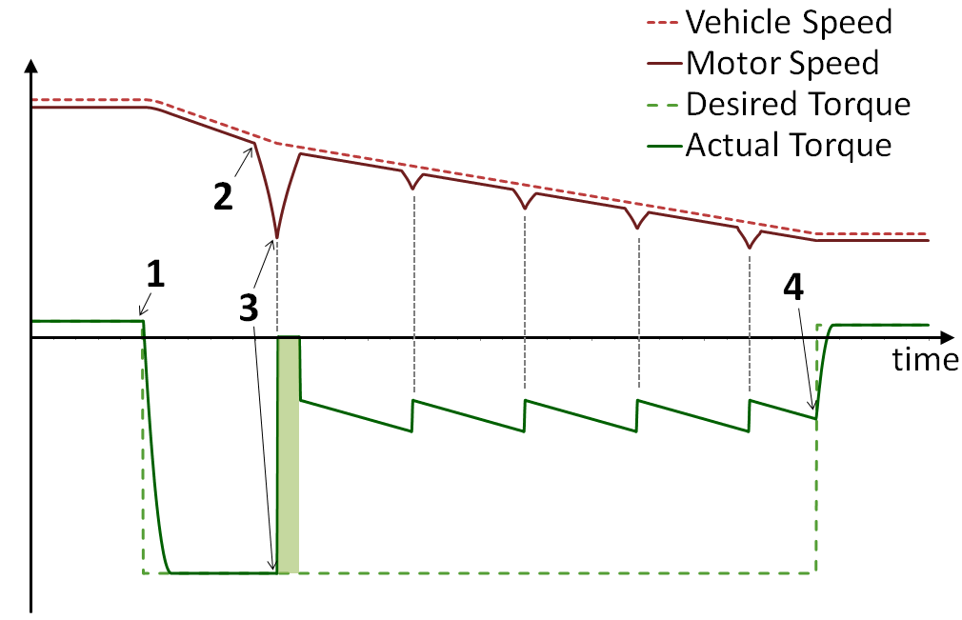
Function Design
Order of Events for Locking Motor
1 | Driver requests negative torque
2 | Vehicle on low friction surface
3 | Reduction of torque by anti-lock
 | Trying to stay on friction limit
4 | Driver releases negative torque
Vehicle speed
Wheel speed
Desired torque
Actual torque
Notes:
Traction = friction between wheel and surface
Traction coefficient = traction force / normal force
Saw tooth type of troque
The following passage, explains a straightforward way to increase the average deceleration force in case of slipping.
An electric vehicle is in the situation of braking on a road surface with varying coefficients of friction. The figure shows simulated curves of motor speed, vehicle speed and also actual and desired torque.
The driver pushes the brake pedal, and thus expresses his braking command, during the transition from point 1 through point 4. The electric motor, in combination with the braking system, provides a negative torque very quickly. This reduces the vehicle speed, optimally down to the limit of frictional force closure.
Right before point 2, the vehicle reaches a slippery surface. In such a case, the braking force could be too high and the wheels begin to lock up. The system detects this situation and reduces the torque up to a level, where the wheel is not locked up any more (point 3). Again, the system consequently increases the torque up to the limit of frictional force closure, in order to maximize the recuperated energy. This release-and-increase is repeated until the braking demand of the driver stops (point 4).

Slide 13
Slip Detection
Conventional Slip Detection
Two types of input
breaking pedal pushed → hydraulic brake
acceleration pedal released → motor
Problem: Time delay due to communication and control
Wheel
speed
Motor
Limiter
Anti
Jerk
Field
oriented
control
Electronic
Stability
System
Vehicle
Control
Unit
Inverter
CAN
Notes:
In conventional and electric vehicles the brake pedal or the accelerator pedal can trigger deceleration in the vehicle. The recuperation demand can also be read in separately and directly using a rocker switch.
The brake pedal is classically considered to be the input medium for the drivers braking demand. In this case, disc or drum brakes are used in order to reduce the speed of the vehicle.
In electric vehicles, the recuperation demand often can also be set by releasing the accelerator pedal. Thus, the electric motor is emulating the familiar drag torque of vehicles with an internal combustion engine. The physical differences are that the drag torque of the electric motor is freely adjustable and the recuperated energy can be used to charge the battery. Furthermore, the accelerator induced braking is seen as auxiliary brake system and consequently the required safety and reliability requirements such as the maximum deceleration forces are lower.
The communication and control delays appear to be an issue to some extent for the conventional electronic stability system. At first the stability system has to calculate the maximum negative torque based on the measured wheel speed. In order to change the recuperation request, it is two times sent via CAN and has to be fed into the strategies of two additional control units until the electric motor reacts.
The delays are not safety-critical because the stability system uses mainly the fast additional control path via the hydraulic circuit to stabilize the vehicle. However, the control in the stability system has to consider these delays.

Slide 14



Slip Detection
Slip Detection inside the Inverter
Anti-Lock → drag torque control
Drag torque = input via acceleration pedal
Usage of inverter signals only
→ Fast reaction on blocking wheels
Wheel
speed
Motor
Limiter
Anti
Jerk
Field
oriented
control
Electronic
Stability
System
Motor
speed
$$ω$$
State
Detect.
Vehicle
Control
Unit
$$M_{Des}^{∗}$$
Driver
demand
Actual
torque
$$M_{act}$$
Inverter
$$φ, ω, M$$
CAN
Notes:
The underlying goal of the new way of slip detection and drag torque control was to increase the dynamics of the reaction on the wheel and to use inverter signals only.
In vehicle dynamics, the slip (formula 6) can be rewritten with the speed of the vehicle $v_{v}$ and the lateral component of the rotational speed of the wheel $v_{wh}$ as
$λ=\frac{v_{v} − v_{wh}}{v_{v}}$ (8)
For an anti-lock brake system the speed of all four wheels have to be measured in order to get the vehicle speed. In contrast to this, the inverter only measures the speed of the motor $n_{motor}$, which reflects the average $v_{wh}$ of the two wheel speeds $v_{left}$, $v_{right}$ of the drive axle.¹⁾
$v_{wh}=\frac{2π∙r_{dyn} }{i_{trsm}}∙n_{motor}=\frac{1}{2}\left(v_{left}+v_{right}\right)$ (9)
The formula shows the relationship between the speed figures assuming a stiff axle, with the dynamic wheel radius $r_{dyn}$ and the transmission ratio $i_{trsm}$.
The internal signals of the inverter include
the driver demand as required drag torque
the motor speed, as indicator for the averaged wheel speed $v_{axle}$ and
the actual torque.
In order to calculate the slip by formula, the speed of the vehicle $v_{v}$ is missing.
_____
¹) The common topology for hybrid and electric cars is based on one electric motor driving the axle of two wheels.

Slide 15












Slip Detection
Slip Detection inside the Inverter
Vehicle speed
Wheel speed
Desired torque
Actual torque
$$\left[ ,μ,state, Δλ\right]$$
Motor
Limiter
$$M_{Des}^{∗}$$
Anti
Jerk
Retract.
torque
control
Field
oriented
control
$$state$$
$$v_{wh}$$
$$ω$$
State
Detect.
Vehicle
Control
Unit
Friction
coeff.
estim- ator
State
Machine
Slip
model
$$φ, ω, M$$
$$\frac{v_{v}−v_{wh}}{v_{wh}}$$
Vehicle
model
New Concepts for Drag Torque Control
in the Power Electronic Control Unit,
T. Fischer and S. Müller,
SAE Technical Paper, 2014-01-1910 (2014)
CAN
$$M_{act}$$
_
$$M_{act}$$
Inverter
$$Δλ$$
$$λ$$
$$v_{v}$$
Notes:
The vehicle model calculates the speed of the vehicle $vv$ by integration of the acceleration $av$, where $av$is computed by the various torques and forces on the wheel. The torque of the electric motor $Mmotor$, the inertia torque $Minertia$, as well as friction force $Ffric$ and downhill force $Fdownhill$ have to be considered (see equation 10). The vehicle mass $mv$ must also be calculated, in order to derive the acceleration from the torque.
$vv=\int{av dt=}\frac{1}{m_{v}}\int{F_{axle} dt=}$
$= \frac{1}{m_{v}}\int{\frac{1}{r_{dyn}}\left(M_{motor}∙i_{trsm}+M_{inertia}\right){+F}_{fric}{+F}_{dwonhill} dt}$ (10)
The slip model estimates the actual slip $λ$ based on the modelled speed of the vehicle $v_{v}$ and of the wheel $v_{wh}$, given by the equations 7-10. The main feature of the shown slip detection is the use of the slip difference $Δλ$ between two time steps.
The state machine depends on a hysteresis with the slip difference as input and switches between the following states: “no drag control”, “retraction of torque required” or “increase of torque possible”.
The friction coefficient estimator calculates the friction coefficient by formula 8. The force $F_{N}$ is derived from the mass of the vehicle $m_{v}$ and the slope of the road, given by the angle $α$. The maximum transmittable torque $F_{axle,max}$is derived from the actual torque before the slipping event.
$μ=\frac{F_{axle,max} }{F_{N}}=\frac{F_{axle,max} }{m_{v}∙g∙\cos\left(α\right)}$ (11)
The retraction controller forwards the unchanged torque request for the state “no torque control”. Given the state “retraction of torque required” it calculates a retracted torque by $μ$.In the state “increase of torque possible” the torque is again slowly incremented.

Slide 16
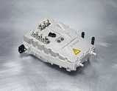
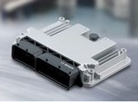
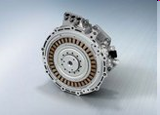
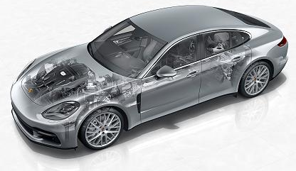
Slip Detection
Relevant Hardware
Series Vehicle - Parallel Hybrid (P2)
Inverter Bosch INVCON 2.0 (µC: Tricore 150MHz)
Motor IMG 300 (max. 300Nm, 33kW)
8 gear transmission
Torque converter
Validation on test track at Bosch Engineering
Power
electronics
ECU
Electrical
machine
Source: Porsche, Bosch
Notes:
The algorithm was validated on a prototype vehicle.

Slide 17
Slip Detection
Relevant Adaptations
Calibration for higher recuperation torque
Combustion engine deactivated
Stability system deactivated
Software implementation of slip detection in inverter
Power
electronics
ECU
Electrical
machine
Source: Porsche, Bosch
Notes:
The prototype vehicle was based on a commercial vehicle, with the following changes:
the limit for maximum drag torque was widened in order to allow a higher recuperation potential,
the available combustion engine was deactivated,
the electric stability system was deactivated, and
the debugging interface of the inverter was used, in order to implement the slip detection in the software of the inverter.

Slide 18
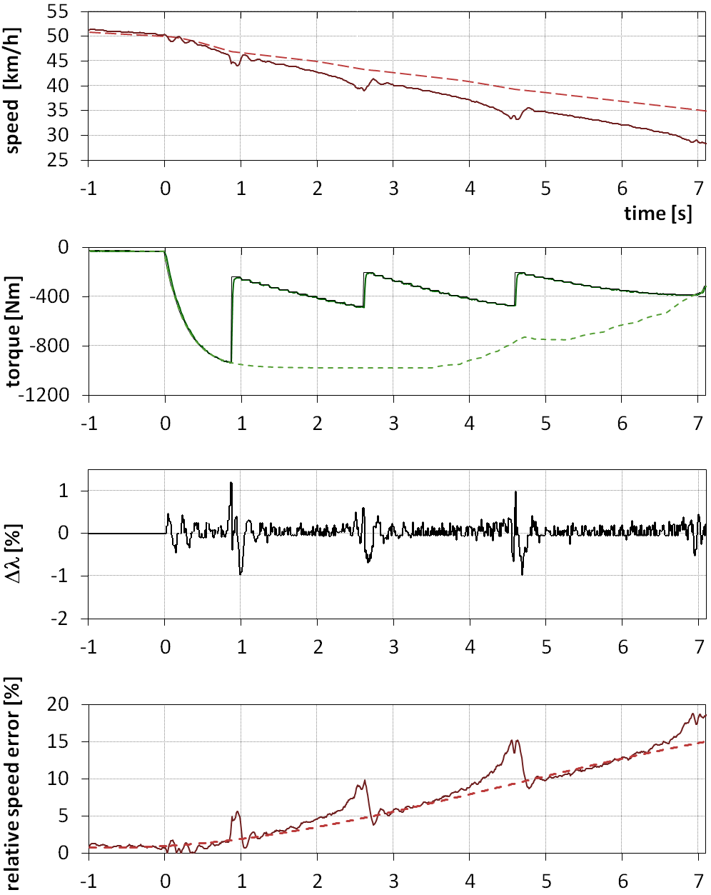
Slip Detection
Breaking on low Friction Surface
Steep change of Δλ at 0.9 sec
Abrupt reduction of torque
Unlocking of wheel
→ Detection of blocking wheels w/o additional sensors possible
Notes:
The results are discussed below.
The first diagram shows the modeled speed of the vehicle (dashed red line) and the averaged speed of the wheels (solid red line). These values are extracted by the inverter variables, as mentioned before. At the time 0 sec, the driver demands a strong recuperation torque, which leads to a decrease of the vehicle speed. Around 0.8 sec, the wheels drive on a surface with low friction. The adhesion drops at this point and consequently the wheels decelerate stronger than the vehicle.
Similarly in the second diagram, the slip change $Δλ$ over the course of time is deflected from zero and increases to a value higher than a given limit. The third diagram depicts the driver demanded torque (dashed green line), the set torque of the slip controller (solid green line), and the actual torque, derived from the series software (black line). The actual torque directly follows the set torque; as a consequence the green line overlaps the black line. As a result to the detected drag torque mismatch, the torque controller releases the torque to reach a lower value, which was calculated online. When the slip-decrease is detected, the recuperation torque will be increased again until the slip change again causes a torque release. This is continuing until the recuperation demand of the driver is reduced and meets the drag controlled torque (cf. at 7 sec in the figure).
It is also worth to mention, that there is a visible drift between the modeled speed of the vehicle and the speed of the wheels (i.e. the speed of the electric motor) in the first diagram. This is due to the fact, that the vehicle speed is derived based on the integration of the accelerating forces, and therefore tend to sum up errors.
It should be stressed, that this has no consequence on the functionality, due to the fact, that only the slip change $Δλ$ is applied for detection.

Slide 19
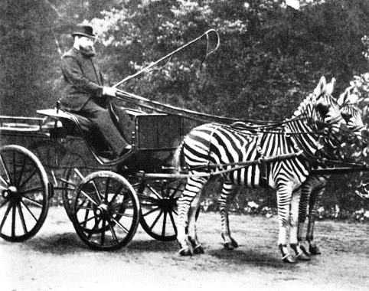
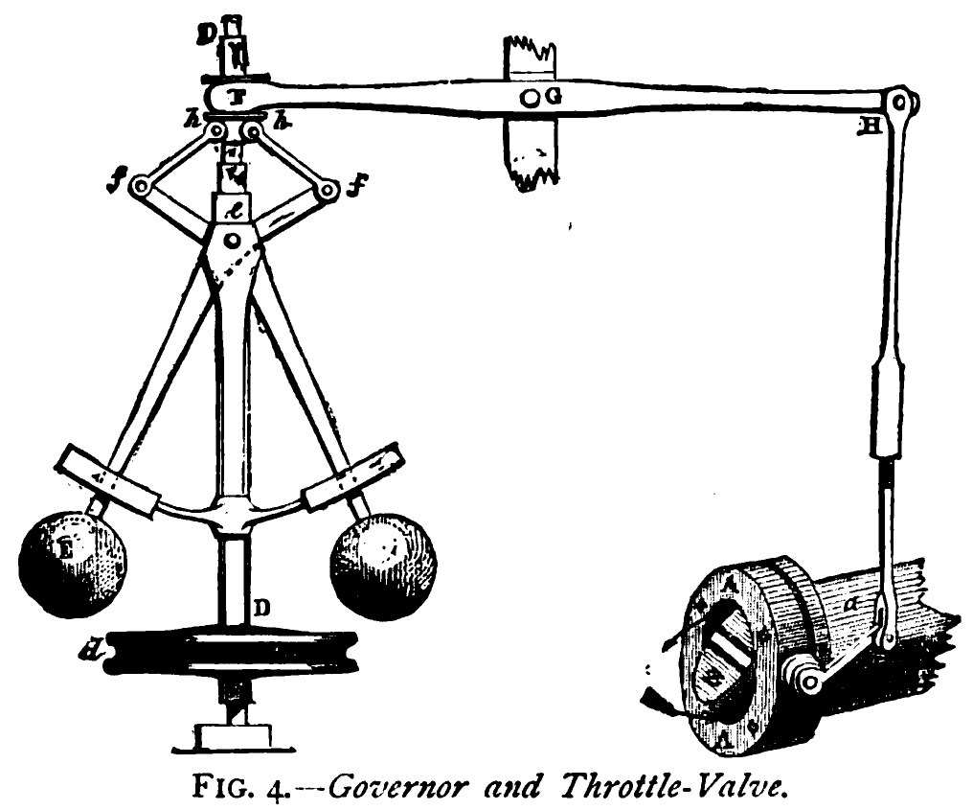
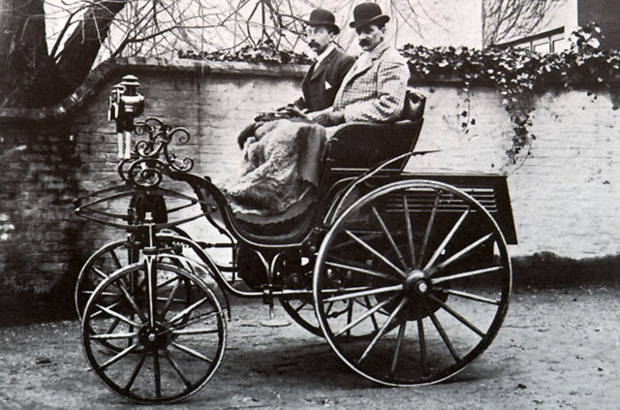
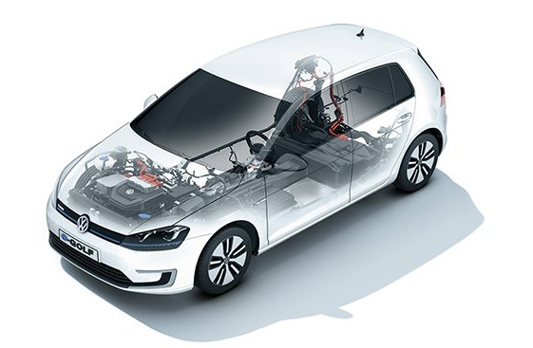
Summary and Outlook
Source: volkswagen
Notes:
price for Tricore about 10…15 €
In order to catch a glimpse of the algorithms in automotive inverters, the application of two types of control were shown in the presentation.
The motor control was reduced to PI controller, governing the transformed voltages. Besides this important algorithm, the inverter software has to provide further functions.
One important fact is, that the resources of the control unit are limited. The often used CPU Tricore TC17XX is able to be clocked at 200..300MHz. The fastest cycle of the control software is 10kHz, which thereby defines the pulse width frequency of the voltage output. Therefore, the full functionality of the inverter software has to be implemented in much less than 30‘000 instructions, given the fastest cycle.
This consideration emphasizes the demand for efficient coding and task scheduling in slower tasks. It leads to simple and robust implementation of controls, which is possible by a proportional-integral algorithm (the picture on the left shows a mechanical implementation of the proportional part of the controller).
One result of the demonstration of slip detection in the inverter was a closer collaboration with other control units - on software basis and work basis.
It is a fact that specifications and boundary conditions of the electric drive and the combustion drivetrain differ strongly. However, most of the present electric vehicles are designed similar to vehicles with combustion engines (cp. first cars and horse carriages in right picture) – also when the architecture under the hood is considered.
With the focus on dynamics of torque, compactness of installation space and fast charging, the differentiation of the electric vehicles can be expected. Possible impact for the electronics might include a relocation of functionalities between battery, brake, inverter and motor.

Slide 21
Appendix

Slide 22

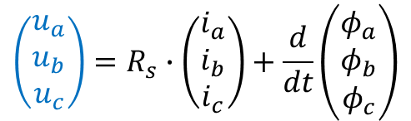
Field oriented Control
b
… from another angle
Phase voltages by voltage drop and induction
Transformation to 2-phase Rotor-oriented coordinates with rotor flux $φ_{PM}$
L
a
R
$$\left(\begin{matrix}u_{a} \\ u_{b} \\ u_{c}\end{matrix}\right)=R_{s}∙\left(\begin{matrix}i_{a} \\ i_{b} \\ i_{c}\end{matrix}\right)+\frac{d}{dt}\left(\begin{matrix}φ_{a} \\ φ_{b} \\ φ_{c}\end{matrix}\right)$$
c
$$\left(\begin{matrix}u_{d} \\ u_{q}\end{matrix}\right)=R_{s}∙\left(\begin{matrix}i_{d} \\ i_{q}\end{matrix}\right)+\left(\begin{matrix}L_{d} & 0 \\ 0 & L_{q}\end{matrix}\right)∙\frac{d}{dt}\left(\begin{matrix}i_{d} \\ i_{q}\end{matrix}\right)+ω∙\left(\begin{matrix}{−L}_{q}∙i_{q} \\ L_{d}∙i_{d}+φ_{PM}\end{matrix}\right)$$
q
φ_{PM}
S
N
d

Slide 23
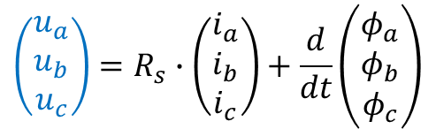
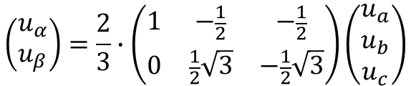
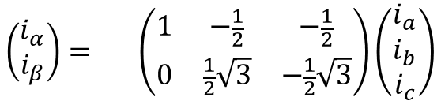

Field oriented Control
… from another angle
b
β
Transformation from 3 phases to 2 phases
With
follows
$$\left(\begin{matrix}u_{a} \\ u_{b} \\ u_{c}\end{matrix}\right)=R_{s}∙\left(\begin{matrix}i_{a} \\ i_{b} \\ i_{c}\end{matrix}\right)+\frac{d}{dt}\left(\begin{matrix}φ_{a} \\ φ_{b} \\ φ_{c}\end{matrix}\right)$$
α
a
c
$$\left(\begin{matrix}i_{α} \\ i_{β}\end{matrix}\right)= \left(\begin{matrix}1 & −\frac{1}{2} & −\frac{1}{2} \\ 0 & \frac{1}{2}\sqrt{3} & −\frac{1}{2}\sqrt{3}\end{matrix}\right)\left(\begin{matrix}i_{a} \\ i_{b} \\ i_{c}\end{matrix}\right)$$
β
q
$$\left(\begin{matrix}u_{α} \\ u_{β}\end{matrix}\right)=\frac{2}{3}∙\left(\begin{matrix}1 & −\frac{1}{2} & −\frac{1}{2} \\ 0 & \frac{1}{2}\sqrt{3} & −\frac{1}{2}\sqrt{3}\end{matrix}\right)\left(\begin{matrix}u_{a} \\ u_{b} \\ u_{c}\end{matrix}\right)$$
α
S
N
d
$$\left(\begin{matrix}u_{α} \\ u_{β}\end{matrix}\right)=R_{s}∙\left(\begin{matrix}i_{α} \\ i_{β}\end{matrix}\right)+\frac{d}{dt}\left(\begin{matrix}φ_{α} \\ φ_{β}\end{matrix}\right)$$

Slide 24

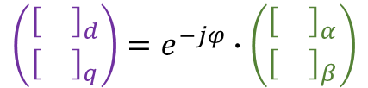

Field oriented Control
… from another angle
β
q
Transformation from stator-oriented to rotor-oriented
with
and expansion of ^{d}/_{dt} follows
α
$$\left(\begin{matrix}u_{α} \\ u_{β}\end{matrix}\right)=R_{s}∙\left(\begin{matrix}i_{α} \\ i_{β}\end{matrix}\right)+\frac{d}{dt}\left(\begin{matrix}φ_{α} \\ φ_{β}\end{matrix}\right)$$
S
N
d
$$\left(\begin{matrix}{\left[\right]}_{d} \\ {\left[\right]}_{q}\end{matrix}\right)=e^{−jφ}∙\left(\begin{matrix}{\left[\right]}_{α} \\ {\left[\right]}_{β}\end{matrix}\right)$$
$$\left(\begin{matrix}u_{d} \\ u_{q}\end{matrix}\right)=R_{s}∙\left(\begin{matrix}i_{d} \\ i_{q}\end{matrix}\right)+\frac{d}{dt}\left(\begin{matrix}φ_{d} \\ φ_{q}\end{matrix}\right)+ω∙\left(\begin{matrix}{−φ}_{q} \\ φ_{d}\end{matrix}\right)$$

Slide 26


Field oriented Control
… from another angle
β
q
Substitution of flux
with
follows
$$\left(\begin{matrix}u_{d} \\ u_{q}\end{matrix}\right)=R_{s}∙\left(\begin{matrix}i_{d} \\ i_{q}\end{matrix}\right)+\frac{d}{dt}\left(\begin{matrix}φ_{d} \\ φ_{q}\end{matrix}\right)+ω∙\left(\begin{matrix}{−φ}_{q} \\ φ_{d}\end{matrix}\right)$$
α
S
N
d
$$\left(\begin{matrix}φ_{d} \\ φ_{q}\end{matrix}\right)=\left(\begin{matrix}L_{d} & 0 \\ 0 & L_{q}\end{matrix}\right)∙\left(\begin{matrix}i_{d} \\ i_{q}\end{matrix}\right)+\left(\begin{matrix}φ_{PM} \\ 0\end{matrix}\right)$$
$$\left(\begin{matrix}u_{d} \\ u_{q}\end{matrix}\right)=R_{s}∙\left(\begin{matrix}i_{d} \\ i_{q}\end{matrix}\right)+\left(\begin{matrix}L_{d} & 0 \\ 0 & L_{q}\end{matrix}\right)∙\frac{d}{dt}\left(\begin{matrix}i_{d} \\ i_{q}\end{matrix}\right)+ω∙\left(\begin{matrix}{−L}_{q}∙i_{q} \\ L_{d}∙i_{d}+φ_{PM}\end{matrix}\right)$$

Slide 27

Field oriented Control
Two Types of Forces
Analysis of voltage terms
Derivation of torque
Torque generation by
Lorentz force (${\sim i}_{q}∙φ_{PM}$) Reluctance force ($\sim i_{q}∙i_{d}∙\left(L_{d}{−L}_{q}\right)$)
$$\left(\begin{matrix}u_{d} \\ u_{q}\end{matrix}\right)=R_{s}∙\left(\begin{matrix}i_{d} \\ i_{q}\end{matrix}\right)+\left(\begin{matrix}L_{d} & 0 \\ 0 & L_{q}\end{matrix}\right)∙\frac{d}{dt}\left(\begin{matrix}i_{d} \\ i_{q}\end{matrix}\right)+ω∙\left(\begin{matrix}{−L}_{q}∙i_{q} \\ L_{d}∙i_{d}+φ_{PM}\end{matrix}\right)$$
$$P_{mech}=P_{el}={k∙\left(u_{d}∙i_{d}+u_{q}∙i_{q}\right)}_{}\overset{→}{ } ω∙M =ω∙k∙i_{q}∙\left(\left(L_{d}{−L}_{q}\right)∙i_{d}+φ_{PM}\right)$$
N
B_{Stator}
S
Notes:
Structure of equation is similar to PT1 K u(t) = T d/dt y(t) + y(t)
Plus dependence on other orthogonal (q/d) coordinate

Slide 28











Field oriented Control
Control
$$i_{qAct}$$
q
a
$$i_{dAct}$$
d
b
c
P
$${k_{q}∙i}_{qAct}$$
$$i_{\left[a,b,c\right]Act}$$
P
$${k_{d}∙i}_{dAct}$$
M_{Des}
Table
$$i_{qDes}$$
-
PI
$$u_{qDes}$$
$$u_{\left[a,b,c\right]Des}$$
Motor
$$\frac{U_{S}}{ω}=φ_{S}$$
q
a
d
b
Table
$$i_{dDes}$$
PI
$$u_{dDes}$$
c
-

Slide 29
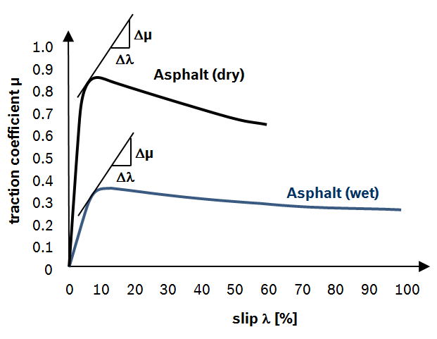
Relevant work on Traction Torque Control in Power Electronics
Maximum Transmissible Torque Estimation (MTTE)
Magic formula; modeling of μ-λ characteristics
Trigonometric calculation
→higher CPU load or RAM consumption
maximum traction coefficient µ
Notes:
Magic Formula: F_{x} = f(κ, F_{z}) = F_{z}·D·sin( C·arctan[ { Bκ – E·[ Bκ – arctan(Bκ) ] } ] )

Slide 30
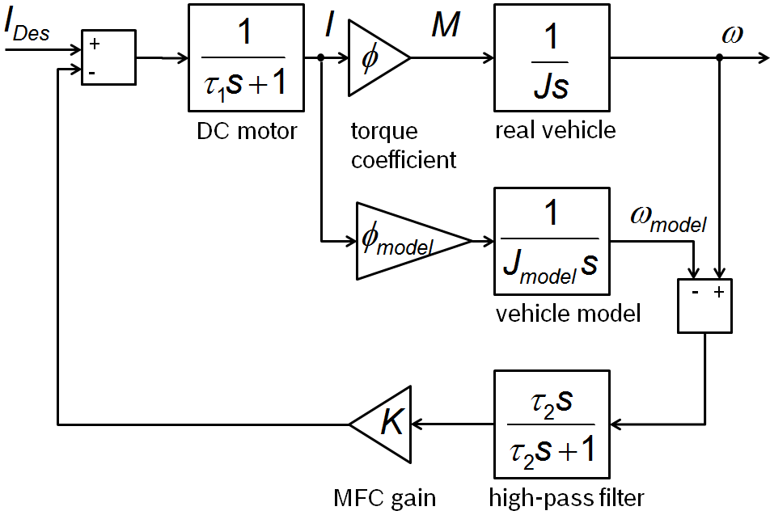
Relevant work on Traction Torque Control in Power Electronics
Model-following control (MFC)
Implicit slip control
Low CPU load, low RAM consumption
No abrupt reaction to locking

Slide 31
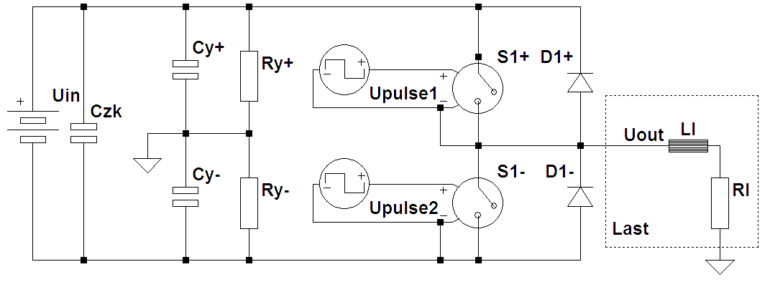

Inverter
PWM-Generation
One half bridge per phase
Each half bridge must supply a sinusodial voltage
Sampling of sinusodial voltage
Desired frequency $f_{Magn.Field}$
Essentially : $f_{Magn.Field}≪f_{PWM}$
$f_{PWM}$ limited by swiching losses and CPU load
$f_{PWM}$ at Bosch: 9 or 10 kHz, Tesla Roadster: 32kHz

Slide 32
3-Phase Inverter
Setup of a 3-Phase 2-Level Inverter
HB1
HB2
HB3
3 half bridges in parallel
Ungrounded star point
Virtual ground
Reference point für voltages
Geometric reference frame (α, jβ ) for resulting vectors
PWM switching states = space vector
≙ Low Side switch (S_{LSx}) conducting ≙ High Side switch (S_{HSx}) conducting
jβ
U_{DC} /2
S_{HS1}
L2
S_{HS2}
S_{HS3}
i1
U_{DC}
i2
u20
L1
i3
α
-U_{DC} /2
u20
u30
u10
S_{LS1}
S_{LS2}
S_{LS3}
u30
L3
u10
0
Voltage space vector | PWM switching states |  |  | Voltages
 | HB1 s1 | HB2 s2 | HB3 s3 | u10 | u20 | u30
U0 | 0 | 0 | 0 | -Udc/2 | -Udc/2 | -Udc/2
U7 | 1 | 1 | 1 | +Udc/2 | +Udc/2 | +Udc/2
U1 | 1 | 0 | 0 | +Udc/2 | -Udc/2 | -Udc/2
U2 | 1 | 1 | 0 | +Udc/2 | +Udc/2 | -Udc/2
U3 | 0 | 1 | 0 | -Udc/2 | +Udc/2 | -Udc/2
U4 | 0 | 1 | 1 | -Udc/2 | +Udc/2 | +Udc/2
U5 | 0 | 0 | 1 | -Udc/2 | -Udc/2 | +Udc/2
U6 | 1 | 0 | 1 | +Udc/2 | -Udc/2 | +Udc/2
1
jβ
α

Slide 33
3-Phase Inverter
Power Quadrants
torque
+M
Generator (braking)
energy flow: electric Machine → Battery
Motor (accelerating)
energy flow: Battery → electric Machine
II
I
1. gear
2. gear
3. gear
4. gear
5. gear
speed
-n
drag torque
+n
Motor (accelerating)
energy flow: Battery → electric Machine
Generator (braking)
energy flow: electric Machine → Battery
reverse
III
IV
-M

